Slide 1
Map Skills

Slide 2
Land Area

Slide 3
Population

Slide 4
HEP

Slide 5
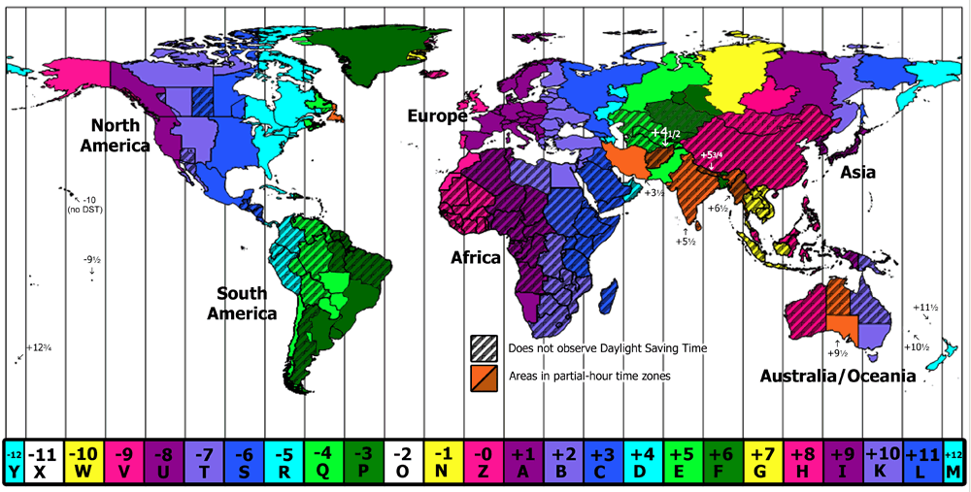
Timezones

Slide 6
